Slide 1
Sensitive Waters:
303(d)
TMDLs
ARC and
ORW
Part 4 of
Stormwater 101 Training
Prepared by INCOG for
Green Country Stormwater Alliance (GCSA)
January 2021
Notes:
Welcome to the last of 4 Presentations addressing the basics of stormwater permitting in Oklahoma, including city and county requirements under your permit.
Five Stormwater 101 Workbooks were planned, but all topics of Workbook 5 have been incorporated into the first 4.
Part 4 covers what can be called “sensitive waters”, referred to as “Special Conditions” in Part IV of the 2021 OKR04 permit.
These are waterbodies that are 303(d) impaired, have completed TMDLs, are identified as Aquatic Resources of Concern (ARC) and/or as Outstanding Resource Waters (ORW).

Slide 2
About This Workbook
This Part 4 is the last of INCOG’s Stormwater 101 Workbook series.
These 4 Workbooks cover basic stormwater permit information for permitted cities and counties.
The target audience has been new local program managers and staff, along with elected officials and management.
The OKR04 permit program reaches across most aspects of a city or county, including Public Works, engineering, planning, legal and finance.
This Part 4 Workbook addresses special types of water quality and waterbodies, often called “Sensitive Waters”.
Material presented focuses on the new 2021 OKR04 requirements.
Notes:
The OKR04 permit program affects many important aspects of municipal operations.
The local OKR04 Program Manager must have cooperation from many municipal departments.
These include Public Works, Engineering, Planning, Legal and Finance as well as support from management and elected officials.
City or county management and elected officials must be knowledgeable about the OKR04’s many requirements.
It is they who must approve compliance strategies and fund program implementation needs.

Slide 3
Defining Sensitive Waters Terms
303(d) – Biennial report to Congress on impaired waters; found as Appendix C in ODEQ’s Integrated Report.
TMDL - Total Maximum Daily Load; a special study that sets load limits of 303(d) pollutants.
ARC - Aquatic Resources of Concern; waterbodies having rare or endangered species and their critical habitat that require extra protection (set by ODWC and USFWS).
ORW – Outstanding Resource Waters; given special protection due to their exceptional water quality.
Notes:
There are 4 categories of Sensitive Waters addressed in OKR04: 303(d), TMDLs, ARC and ORW.
303(d) is a section from the federal Clean Water Act that requires a report to Congress from each state biennially (every 2 years) listing all waterbodies determined to be impaired.
TMDLs are a special type of pollutant control study called a Total Maximum Daily Load usually performed on 303(d) listed waterbodies.
ARC (Aquatic Resources of Concern) are designated waterbodies or watersheds in Oklahoma needing special protections for endangered or threatened species and their critical habitat.
ORW (Outstanding Resource Waters) are defined in Oklahoma’s Water Quality Standards (WQS) as waterbodies of exceptional high quality needing special protections.

Slide 4
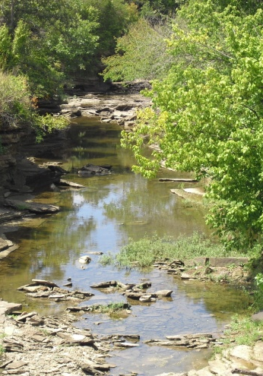
Oklahoma WQS Beneficial Uses
Public and Private Water Supply
Emergency Water Supply
Fish and Wildlife Propagation
    Habitat Limited Aquatic Community
    Warm Water Aquatic Community
    Cool Water Aquatic Community
    Trout Fishery (put and take)
Recreation (Primary & Secondary Body Contact)
Agriculture
Aesthetics
Navigation
Fish Consumption
BU combinations are designated for every waterbody in the State.
Notes:
Oklahoma’s Water Quality Standards (WQS) are designed to protect how Oklahoma’s water resources are used.
Categories of uses, called Beneficial Uses, include water supply, fish and wildlife propagation, recreation, agriculture, aesthetics, navigation and fish consumption.
Every waterbody in Oklahoma has Beneficial Uses assigned to it, depending upon how each waterbody is most likely to be used.
The WQS then assign numeric and non-numeric (“narrative”) criteria to protect each Beneficial Use.
Discharge permits issued by DEQ set limits on the amount of pollutants that can be discharged to protect the uses.
Stormwater permits are just another kind of discharge permit. They are written to ensure that Oklahoma’s WQS and Beneficial Uses are protected.

Slide 5
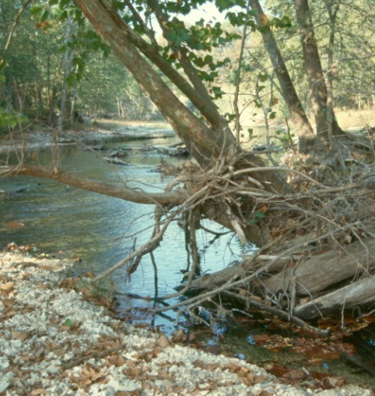
303(d) Impairment
Nonattainment of one or more Beneficial Uses can be caused by:
Dissolved oxygen, nutrients
Toxics (metals, organics, pesticides, “unknown”)
Sediment, suspended solids, turbidity
Pathogens (bacteria)
Biological (fish, macroinvertebrates)
pH
Oil & grease
Chloride, sulfate, TDS
Notes:
The causes of 303(d) impairment can be from any type of pollutant, such as too little dissolved oxygen, nutrients that cause excess algae growth, many types of toxic compounds.
Other types of 303(d) pollutants include heavy metals, too much sediment, pathogenic bacteria, pH extremes, oil & grease, and too much salt (dissolved solids).
303(d) listings can also be defined for waters having fish or macroinvertebrate communities that are too stressed to support a healthy ecosystem.

Slide 6

The Oklahoma 303(d) List
2018 is the latest 303(d) List; approved May 2020.
Typical lag time of around 2 years (lengthy approvals).
Science-based. Formal sampling required.
Uses the OWRB’s Chapter 45 WQS and Chapter 46 303(d) assessment procedures.
DEQ coordinates the assessments: DEQ & OWRB are working to automate portions of the assessment process.
303(d) impairments apply to the WQS Beneficial Uses.
Most waterbodies remaining 303(d) listed will have TMDLs.
Notes:
The latest version of the biennial 303(d) list was approved in May 2020. The list is actually Appendix C in Oklahoma’s more comprehensive “Integrated Report”.
It takes about 2 years of technical development and review to update the 303(d) list.
The list date reflects when the process began, not when it was completed.
Oklahoma uses formal science-based procedures for making 303(d) impairment decisions.
These procedures are in Chapter 46 of the WQS, and they use the numerical and narrative criteria in Chapter 45 of the WQS to assess Beneficial Use “attainment”.
Most waterbodies that remain on the list will have a TMDL study to set pollutant limits so that impairment status can be remedied.
A few waterbodies may have an alternative kind of study called a Watershed Based Plan.
OKR04 requires that both TMDLs and Watershed Plans must be complied with by permitted MS4s.

Slide 7
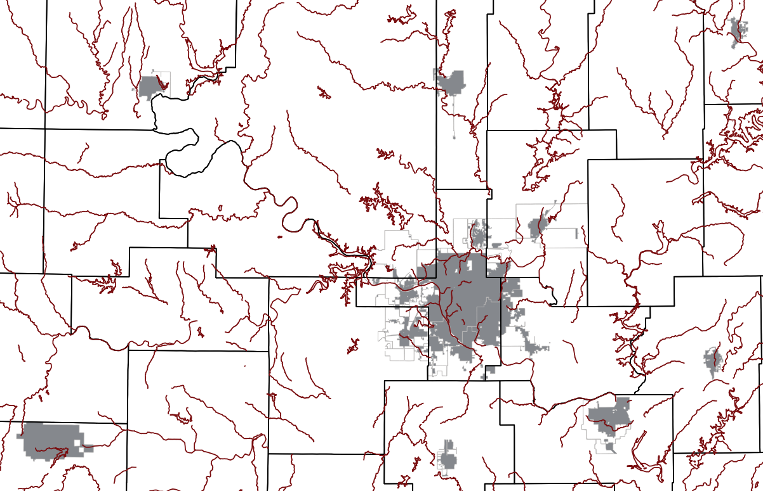
2018 303(d) Waters By GCSA Member MS4s
Every GCSA Member has at least one 303(d) impaired waterbody within its MS4.
OKR04’s “Special Conditions” has numerous 303(d) requirements.
Notes:
DEQ updates its 303(d) database and GIS layers every 2 years so that listed waterbodies can be located.
These can be found in the Integrated Report posted on the DEQ website.
DEQ also updates its online interactive map website that also has web pages for downloading water quality data and GIS layers.
Every GCSA Member has at least one 303(d) impaired waterbody within its MS4 area.
The OKR04 permit has a number of requirements permittees must implement to reduce the “Pollutants of Concern” (POCs) that cause the impairment.
The OKR04 permit lists many of these requirements under “Special Conditions” which is Part III of the existing OKR04 and will be Part IV of the new 2021 OKR04 permit.

Slide 8
How 303(d) Segments & Listings Change
Arkansas River segments in Tulsa area.
SEGMENT | 1998 303(d) |  | 2002 303(d) | 2004 303(d) | 2006 303(d) | 2008 303(d) | 2010 303(d) | 2012 303(d) | 2014 303(d) | 2016 303(d) | 2018 303(d)
OK120420010130_00 | Metals Pathogens Pesticides Organics |  | Cat. 2 | Cat. 2 | Cat. 2 | O&G 5a TDS 5a | Turb 5a Thall 5a O&G 5a | Turb 5a O&G 5a Ent 4a | Turb 5a | Turb 5a | Turb 5a Ent 4a
OK120420010010_10 | Metals Pathogens Pesticides Organics |  | Not listed in 2002 IR | Cat. 3 | Cad 5a FC 5a | Cad 5a FC 5a | Cad 5a FC 5a | Cad 5a | Cd 5a | Cd 5a | Cd 5a
OK120420010010_00 |  |  | Lead 5 | FC 5 Ent 5 Ecol 5 | FC 5a Ent 5a Ecol 5a | FC 5a Ent 5a TDS 5a Lead 5a O&G 5a | Turb 5a Thall 5a O&G 5a | Turb 5a O&G 5a Ent 4a | Turb 5a Ent 4a | Turb 5a Ent 4a | Turb 5a Ent 4a
OK120410010080_10 | Pathogens Pesticides Organics |  | Cat. 3 | Cat. 3 | FC 5a | FC 5a | FC 5a | Cat. 2 | Cat. 2 | Cat. 2 | Cat. 2
OK120410010080_00 |  |  | Path 5 TDS 5 | Ent 5 TDS 5 Turb 5 | TDS 5a | Ent 5a TDS 5a O&G 5a | Thall 5a O&G 5a | Ent 4a | Ent 4a | Ent 4a | Ent 4a
Notes:
Two aspects of 303(d) listing can be problematic for MS4s.
First, segmentation of streams is not uncommon. This is where a single 303(d) stream segment is split into 2 or more segments.
Each segment can be listed for its own set of impairment conditions.
Second, listed causes (POCs) can change with each 2-year cycle.
This can pose problems for MS4s that have pursued Best Management Practices (BMPs) to address, say bacteria pollution, only to have to change BMPs to address dissolved oxygen (DO) because the segment’s 303(d) impairment status changed from having bacteria to DO problems.
This table shows how Arkansas River segments through the Tulsa metro area have changed over the past 20 years, both in segmentation and POCs.
Fortunately these types of changes are happening less often than in the past.
It is urgent that each permitted MS4 stay informed about 303(d) status of all waterbodies within their MS4.
Once a 303(d) list is superseded by a later version, the old list is no longer valid. Only the new 303(d) list affects permit compliance.

Slide 9

2021 OKR04’s 303(d) Requirements
The draft 2021 OKR04 permit requires:
IV.A.1.a: List and implement BMPs to reduce 303(d) pollutants of concern (POCs), and describe how the BMPs will reduce POCs.
IV.A.1.b: Your outreach programs must target groups likely to cause impacts and be significant sources of 303(d) pollutants.
IV.A.1.c: Identify the discharges that contribute significant pollutants to your 303(d) impaired waters.
IV.A.1.d: You must locate areas most likely to have significant discharges of 303(d) pollutants.
IV.A.1.d: You must conduct inspections of illicit discharges based upon your priority areas in your 303(d) watersheds.
Notes:
Slides 9 and 10 list the 2021 OKR04 text that requires each MS4 to implement strategies to reduce or eliminate the 303(d) causes of impairment.
Present 303(d) requirements are in Part III of the 2015 OKR04 permit. The draft 2021 OKR04 permit has revised Part III text into an updated Part IV.
Permittees must adopt special BMPs for education outreach targeting the significant sources of POCs.
Inspections must be conducted within the 303(d) watershed within the MS4 to identify and control POC discharges.
Priority areas must be determined for targeted BMPs and inspections.

Slide 10
OKR04’s 303(d) Requirements
Draft 2021 OKR04 permit 303(d) requirements (cont.):
IV.A.1.e: You must implement Operation & Maintenance procedures for structural and nonstructural 303(d) pollutant controls.
IV.A.1.f: You must assess 303(d) water quality impacts from new flood management projects.
IV.A.1.f: You must examine existing projects for possible need for water quality retrofits and practices.
IV.A.1.h: If the 303(d) pollutant is bacteria, OKR04 has 5 categories of additional requirements to implement.
VIII: Optional 7th MCM requires following all requirements in the most recent OKR10 permit.
Notes:
Operation and Maintenance procedures must be implemented that target POC discharges.
New flood management projects must be assessed for 303(d) water quality impacts, and existing projects must be examined for potential water quality retrofits.
If the POC is bacteria (presently Enterococcus or E. coli in the WQS), OKR04 has 5 categories of actions that the MS4 must take to reduce bacteria pollution.
In addition, OKR04’s Part VIII, the optional minimum control measure (7th MCM) for municipal construction, requires compliance with the OKR10 construction permit.
OKR10 has its own 303(d) requirements that must be addressed by MS4s using this 7th MCM.

Slide 11

What Is a Total Maximum Daily Load (TMDL)
A TMDL calculates the maximum allowable pollutant loading for a waterbody.
All point source loads (WLAs) + all nonpoint source loads (LAs) + a margin of safety (MOS).
Stormwater permittees are point sources.
Special WLA just for stormwater permittees: “WLA_MS4”
TMDL = ΣWLA + ΣWLA_MS4 + ΣLA + MOS
Notes:
TMDLs are a very complicated subject, and their rollout by states and EPA has been problematic over the past 25 years.
A TMDL is a special water quality pollutant impact study of the entire watershed of the impaired waterbody.
The sum of all point source pollutant wasteload allocations (WLAs) are totaled, and they are added to the sum of all nonpoint source load allocations (LAs)
The sum of all WLAs and LAs represents a total pollutant load from the watershed.
Daily time frames are used, and the loads are in pounds per day (lbs/d) or for bacteria, in billions of bacteria cells per day.
A Margin of Safety (MOS) is also calculated as a buffer in setting WLAs and LAs due to the uncertainties in the overall TMDL analysis.
Because permitted MS4 stormwater discharges are considered point sources, TMDLs having MS4s will use a special calculation just for MS4s, the WLA_MS4.
Most TMDL studies also calculate a Percent Reduction Goal (PRG) for MS4s, such as 42% load reduction needed.
DEQ is allowing either the WLA_MS4 or the PRG to become the target for the MS4 to meet.
Each MS4 must adopt their target load reduction as a Measurable Goal in their SWMP document.

Slide 12
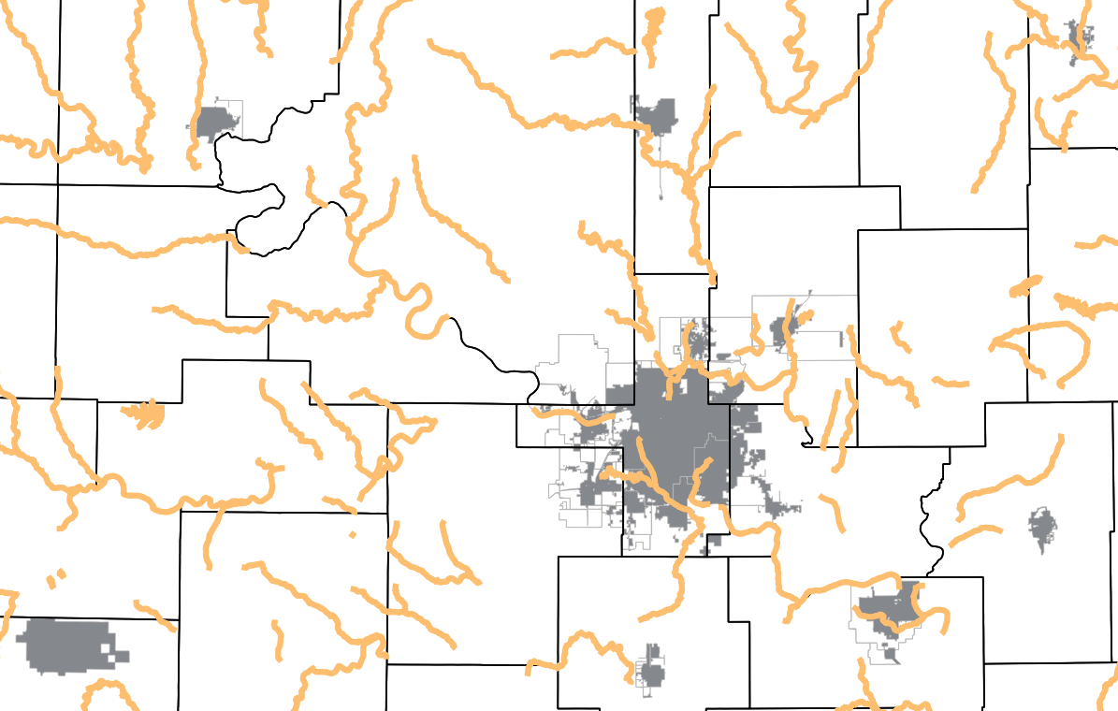
2018 Completed TMDLs Near GCSA Member MS4s
The final list of TMDLs and MS4s are in Table IV-2 of the 2021 OKR04 permit.
Over half of GCSA’s member MS4s will have to comply with TMDLs during this cycle of OKR04.
Notes:
The list of Completed TMDLs in Oklahoma is updated by DEQ every 2 years coinciding with the release of a new Integrated Report with its 303(d) List.
In the present 2015 OKR04 permit there are only general requirements to comply with TMDLs.
This general TMDL strategy is changing significantly in the new permit.
Table IV-2 in the 2021 OKR04 lists specific TMDL Reports and all MS4s that must comply with the TMDLs in each report.
The new permit also greatly expands TMDL compliance requirements for Table IV-2 MS4s.

Slide 13
TMDL Obligations for Dischargers
Permittees With Mandatory TMDL Requirements:
  Stormwater-permitted MS4s (individual and OKR04-listed).
  OKR05 and OKR10 permittees, as applicable.
  NPDES and OPDES-permitted wastewater dischargers.
  CAFOs (Concentrated Animal Feeding Operations).
No Permits = Voluntary Approach:
  MS4s with no stormwater permits.
  Non-CAFO agricultural activities.
  Businesses and landowners with no discharge permits.
Notes:
Not all dischargers and MS4s must comply with TMDLs in their area.
Only MS4s that are listed in Table IV-2 of the 2021 OKR04 permit must comply with the 2021 OKR04’s new TMDL requirements.
OKR05 industrial and OKR10 construction stormwater dischargers may have TMDL requirements.
Businesses that have wastewater permit discharges of POCs may also have to comply with TMDLs if they discharge any TMDL POCs.
Most agricultural activities are exempt unless they have discharge permits such as Concentrated Animal Feeding Operations (CAFOs).
Landowners and MS4s that do not have discharge permits do not have to comply with TMDLs. They are encouraged to comply generally using voluntary practices.

Slide 14
Types of TMDLs Having MS4s
Notification TMDLs (Older TMDLs):
  Those completed prior to November 2013.
  DEQ was to notify each MS4 of activation.
  2021 OKR04 Table IV-2 list will act as DEQ notification.
EPA Approved TMDLs (Newer TMDLs):
  Those completed after November 2013.
  Were to be activated upon EPA approval of TMDL.
  2021 OKR04 Table IV-2 list will act as DEQ notification.
  Only 1 TMDL has been activated so far (Lake Thunderbird).
Notes:
As TMDL reports began to be prepared in the 1990s, the reports stated that MS4s would have to begin complying with the TMDL “upon notification by the Director” [DEQ].
Until late 2013, DEQ did not issue any notifications to MS4s, so compliance was postponed. The one exception was the November 2013 Lake Thunderbird TMDL.
Since 2013, most TMDL Reports changed the text to state that MS4s must begin implementation upon EPA approval of the TMDL.
However, DEQ postponed these new TMDLs pending development of a statewide TMDL compliance strategy for MS4s.
The 2021 OKR04 permit is the first rollout of DEQ’s new TMDL strategy for MS4s.
Completed TMDLs with MS4s are listed in OKR04 Table IV-2. All other MS4s in Oklahoma in other TMDL watersheds do not have to comply with TMDLs at this time.

Slide 15
Types of TMDL Targets
Aggregate WLA_MS4s: (mostly Older TMDLs)
  Calculates a combined WLA_MS4 for all permitted MS4s.
  No individual WLA_MS4 calculated for each MS4.
  DEQ is converting Aggregate to Individual WLA_MS4s.
Individual WLA_MS4s: (mostly Newer TMDLs)
  Newer TMDLs calculate a separate WLA_MS4 for each MS4.
  MS4s must adopt the TMDL’s reduction goal in their SWMP.
    Use either the WLA_MS4 as a Measurable Goal,
    Or the TMDL’s Percent Reduction Goal (PRG).
Notes:
Most pre-2013 TMDLs in Oklahoma calculated a single combined WLA_MS4 load for all MS4s; individual WLA_MS4 loads were not assigned to each MS4.
These are referred to as “Aggregate TMDLs”.
Meeting an aggregated MS4 load is not practical, so DEQ is calculating individual MS4 loads from those old TMDL aggregated loads for each MS4 listed in OKR04 Table IV-2.
DEQ is also allowing flexibility in MS4 target selection in 2021 OKR04 by allowing an MS4 to set their assigned WLA_MS4 load as their target or use the PRG as their load reduction target.
This means that an MS4 listed in OKR04 Table IV-2 can set its TMDL Measurable Goal as either the TMDL’s PRG or its WLA_MS4.

Slide 16
When Must TMDL Compliance Begin
Existing (2015) OKR04:
  Only 1 TMDL activated so far (Lake Thunderbird).
  OKR04 only has general text on TMDL compliance.
  OKR04 has no specific TMDLs listed.
Draft New (2021) OKR04:
  3-4 types of TMDL “Plans” must be developed.
  Table IV-1 is a TMDL implementation schedule.
  Table IV-2 lists specific TMDL Reports with their MS4s.
  OKR04 acts as “notification” of Table IV-2 TMDLs.
Notes:
The present OKR04 does not list specific TMDL Reports nor does it have lists of MS4s that must comply with TMDLs.
The 2021 OKR04 permit adds Table IV-2 showing specific TMDL Reports and all of the permitted MS4s within each report that must begin complying.
In effect, DEQ is “notifying” MS4s of their TMDL obligations with the finalization of the new OKR04.
The permit’s “Effective Date” begins the schedule of all TMDL implementation activities.
OKR04 also has many pages of specific TMDL actions that must be taken by MS4s, including preparation of 3 to 4 types of Plans.
NOTE: These are discussed in greater detail in GCSA Fact Sheets and Workbooks from Zoom meetings. INCOG will work with DEQ to prepare GCSA guidance documents and education outreach on TMDL compliance. INCOG will also host training sessions on TMDLs.

Slide 17
Aquatic Resources of Concern (ARC)
The US Fish and Wildlife Service (FWS) and the Oklahoma Dept. of Wildlife Conservation (ODWC) have primary roles in protecting endangered and threatened species and their critical habitat.
OKR04 protects species and their critical habitat as ARC.
OKR04’s Exhibit I describes and maps ARC areas across Oklahoma.
MS4s with ARC areas must comply with protection requirements.
ARC mainly covered in 2021 OKR04 Part II (Eligibility Requirements) and Part VIII (7th MCM).
2021 OKR04 Part II requires each MS4 to ensure ARC protection at time of application.
Part VIII requires ARC protection for MS4 construction projects.
Notes:
When stormwater permits were first being prepared in Oklahoma, the US Fish and Wildlife Service (FWS) and the Oklahoma Department of Wildlife Conservation (ODWC) identified areas needing special protection for endangered and threatened species and their critical habitats.
These areas are referred to as Aquatic Resources of Concern (ARC).
Each of the 3 stormwater general permits has ARC areas listed along with an Oklahoma ARC map (see OKR04’s Exhibit I shown in slide 18).
Most ARC protection requirements in OKR04 are in Part VIII, the optional 7th MCM for municipal construction.

Slide 18
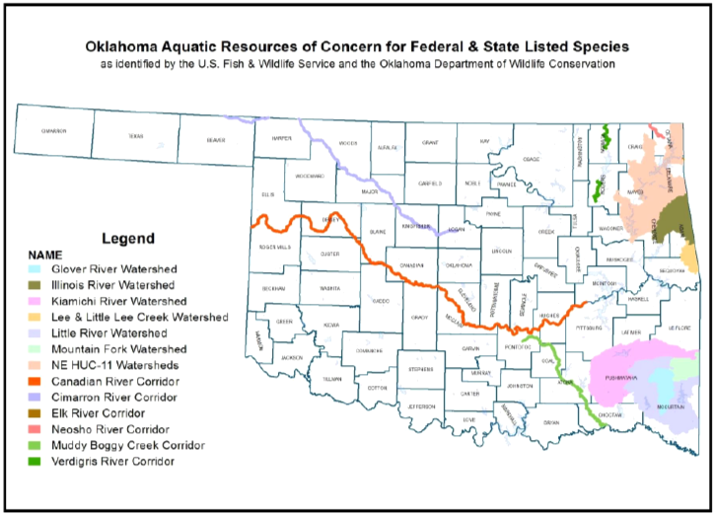
ARC in 2021 OKR04 Exhibit I
Most ARC waterbodies are in far eastern Oklahoma.
Many permitted MS4s in Oklahoma do not have ARC in their MS4s.
Notes:
Impacts to ARC areas must be considered when applying for permit coverage under OKR04’s Permit Eligibility section.
The MS4 must ensure that their activities under the OKR04 permit will not cause harm to species or their critical habitat.
Only those MS4s with ARC areas at least partly within their MS4 must comply with the ARC provisions in OKR04.
The ARC areas are shown in slide 18 and as a map in OKR04’s Exhibit I.

Slide 19
ORW Limited Application in OKR04
Only 1 municipal stormwater permittee must address Outstanding Resource Waters (ORW), Tahlequah.
Tahlequah must produce scientific-based maximum pollutant load targets that existed in 1992.
They must implement extensive sampling to show that they do not exceed the 1992 historic limits.
Setting the 1992 limits involved several years working with DEQ, consultants and others.
The annual burden exceeds what is expected in other Phase II permits or even TMDLs.
The new 2021 OKR04 permit does not expand ORW to new MS4s.
Notes:
Outstanding Resource Waters (ORW) represent a few Oklahoma streams and watersheds of exceptionally high water quality deserving of special protection status in the Oklahoma WQS.
Most prominent of these are the Oklahoma Scenic Rivers.
Only one permitted MS4 in Oklahoma, the City of Tahlequah, has MS4 area within one of these ORW areas.
As such, Tahlequah must meet a wide range of special protection requirements, including ensuring that their MS4 pollutant discharges do not exceed those that existed in 1992.
Significant resources have been devoted to this effort by Tahlequah, and their responsibilities will be ongoing as long as the Illinois River and its tributaries have ORW protection.
The proposed new 2021 OKR04 permit does not expand upon any ORW requirements nor doe it identify any additional MS4s.

Slide 20
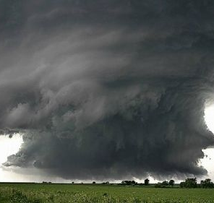
This Ends the GCSA Workbook Series on OKR04 Stormwater Permit Basics.
Please contact INCOG at stormwater@incog.org for more information on these Stormwater 101 Workbooks.
Notes:
This concludes the 4-part Stormwater 101 annotated PowerPoint (aPPT) and Workbook series by INCOG for its GCSA Members.
Over the past year, a third of GCSA Member program managers have been replaced by new people.
Most of these new program managers do not have a thorough background in OKR04 permitting or water quality protection.
INCOG continues to develop education outreach guidance and information which is presented in a growing variety of media
INCOG’s new outreach includes Zoom Meetings and these narrated PowerPoints with companion Workbooks.
Please contact INCOG at stormwater@incog.org or (918) 579-9451 if you have any questions about this material.

